Slide 1


PROJECT PLAN PROJECT X
Christopher Burgos
Joomer Jake Caballero
Leopoldo Dumadangon
Cristian Villanueva

Slide 2
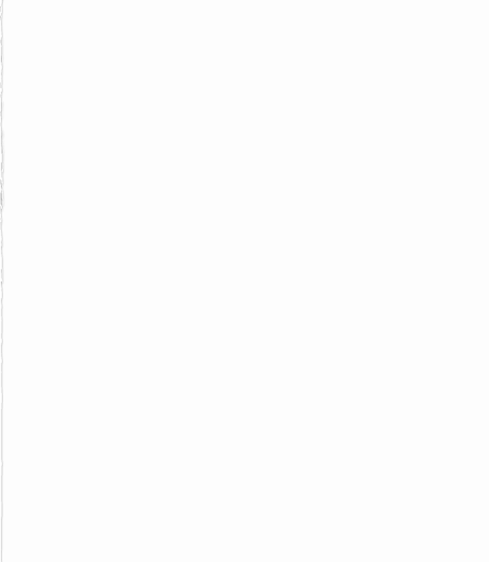
Project X: Automated Attendance System Requirements
R1. User Roles and Access Control
R1.1. The system shall support three primary roles: Lecturer, Student, and Administrator.
R1.2. Only registered lecturers shall be able to record attendance.
R1.3. Only registered devices shall be authorized for attendance recording.
R1.4. Administrators shall have full control over system data (CRUD operations on students, lecturers, devices, and courses).
R2. Attendance Recording and Data Persistence
R2.1. The system shall allow lecturers to record student attendance using a registered mobile device, tablet, or computer.
R2.2. Attendance data shall be stored on a cloud-based MySQL database.
R2.3. Attendance shall be linked to a course, identifying the student, lecturer, date, and time.
R2.4. Attendance shall be retrievable in real-time.

Slide 3
Project X: Automated Attendance System Requirements
R3. Device Registration and Tracking
R3.1. A lecturer shall be able to register multiple devices.
R3.2. The system shall track the location of registered devices in case a lecturer needs assistance.
R3.3. Only registered devices shall be able to access the attendance system.
R4. Student Enrollment and Management
R4.1. Students shall be able to enroll in courses through the system.
R4.2. The system shall store and manage student details, including:
R4.2.1. Name
R4.2.2. University ID
R4.2.3. Profile Picture (captured via the system)
R4.3. The system shall allow adding, updating, and deleting student records.

Slide 4
Project X: Automated Attendance System Requirements
R5. Reporting and Data Access
R5.1. The system shall provide the following reports:
R5.1.1. Attendance reports (by student, by course, by date range).
R5.1.2. List of students per course.
R5.1.3. List of lecturers and their registered devices.
R5.2. Reports shall be accessible to lecturers and administrators.
R6. Photo Capture and Storage
R6.1. The system shall allow lecturers to capture passport-style photos of students.
R6.2. Photos shall be stored as files, and student IDs and names shall be stored in the database.
R6.3. The system shall ensure secure access to stored images.
R7. System Architecture and API Access
R7.1. The system shall use a REST API to interact with the database.
R7.2. All user interactions (attendance, enrollment, reporting) shall be handled through the API.
R7.3.API requests shall be authenticated and authorized.

Slide 5
Project X: Automated Attendance System Requirements
8. Testing Criteria
R8.1. Unit Testing: Each function (attendance logging, student enrollment, etc.) shall be tested in isolation.
R8.2. System Testing: The system shall be tested end-to-end to validate workflows.
R8.3. User Acceptance Testing (UAT): The system shall be tested against the above assertions to confirm it meets user needs.

Slide 6

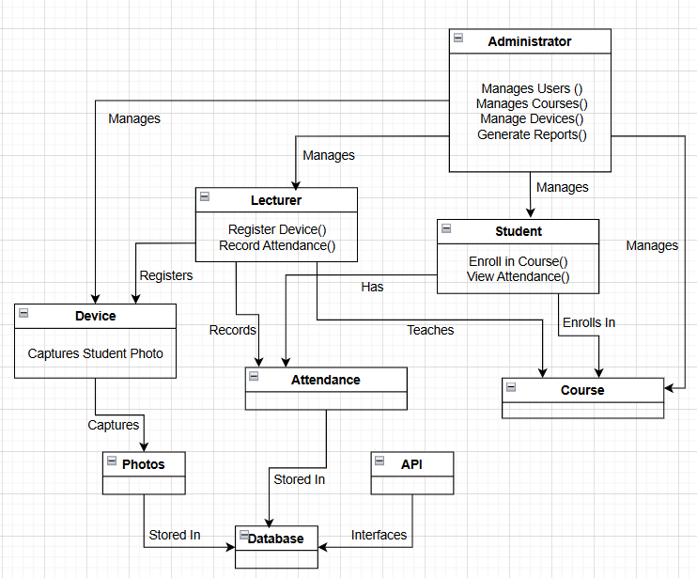
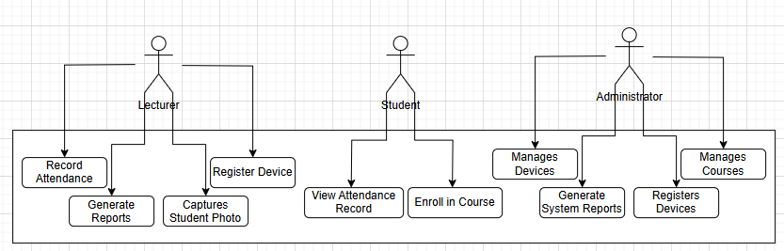
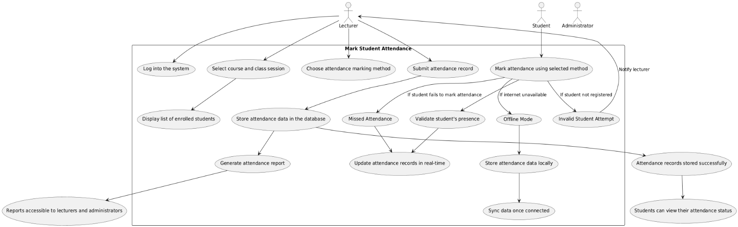
Conceptual Diagram
Use Case Diagram
Packages: Each requirement category (e.g., User Roles, Attendance Recording, etc.) is grouped into a package.
Relationships: Arrows show how requirements are connected or depend on each other.
Hierarchy: Sub-requirements (e.g., R4.2.1, R4.2.2) are nested under their parent requirements.

Slide 7
Use Case Scenario: Automated Attendance System
Use Case: Mark Student Attendance
Actors: Lecturer, Student, and Administrator are defined as actors.
Main Flow: The steps from logging in to generating the attendance report are mapped out.
Alternate Flows: Scenarios like invalid student attempts, missed attendance, and offline mode are included.
Postconditions: The final states after the use case is completed are described.

Slide 8
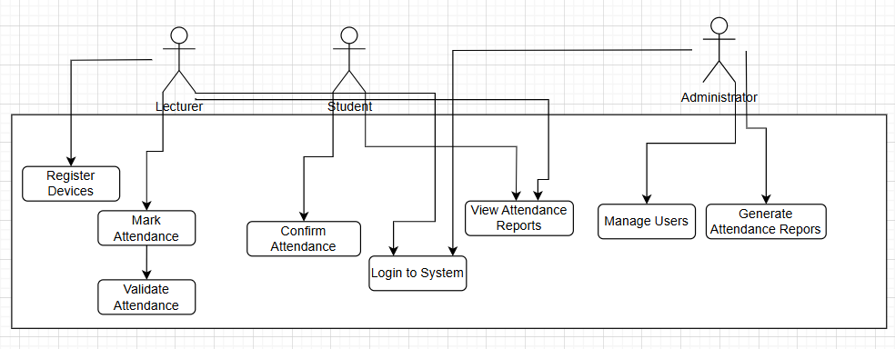
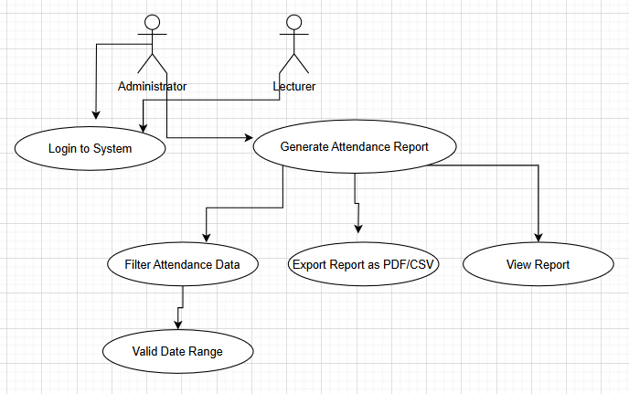
Use Case Scenario: Automated Attendance System
Use Case: Generate Attendance Report
Actors: Lecturer, Student, Administrator.
Use Cases:
Lecturer: Register Devices, Mark Attendance, Confirm Attendance, View Attendance Reports.
Student: Register Devices, View Attendance Reports.
Administrator: Manage Users, Generate Attendance Reports.
Common Use Case: Login to System (included in all actions).
Validation: Validate Attendance is part of Mark Attendance.

Slide 9
Use Case Scenario: Automated Attendance System
Use Case: Generate Attendance Report
Actors: Lecturer, Student, Administrator.
Use Cases:
Lecturer: Register Devices, Mark Attendance, Confirm Attendance, View Attendance Reports.
Student: Register Devices, View Attendance Reports.
Administrator: Manage Users, Generate Attendance Reports.
Common Use Case: Login to System (included in all actions).
Validation: Validate Attendance is part of Mark Attendance.

